Slide 1
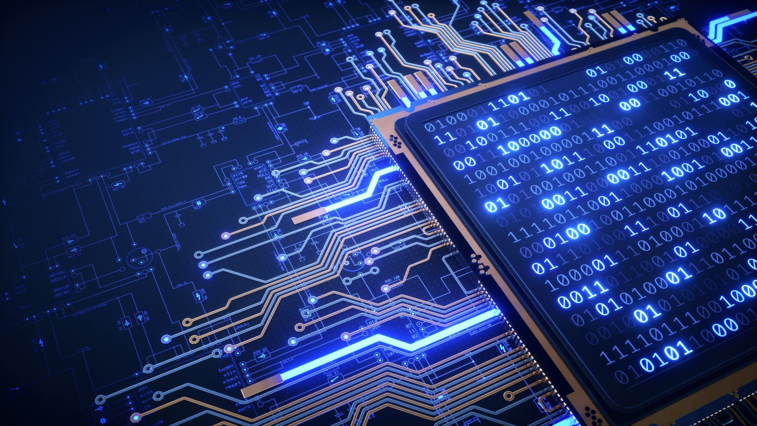
Network Security
CS-411
Lecture # 03 - Cryptography

Slide 2
Cryptography

Slide 3
What is Cryptography
Cryptography is the practice and study of techniques for secure communication in the presence of third parties (called adversaries).
It is about constructing and analyzing protocols that overcome the influence of adversaries and which are related to various aspects in information security such as data confidentiality, data integrity, and authentication.
Modern cryptography intersects the disciplines of mathematics, computer science, and electrical engineering
Modern cryptography follows a strongly scientific approach and designs cryptographic algorithms around computational hardness assumptions making such algorithms hard to break by an adversary.
It is theoretically possible to break such a system, but it is infeasible to do so by any practical means

Slide 4
Computational Hardness
Project: Scheduling Jobs on computers
Each Job has fixed sizes
Input is set of Jobs
Sizes s1, s2, …….., sn
Schedule on two Processors P1 and P2
Automate this process
Scheduling should be such that last job finishes ASAP (Optimal time)
Solution 1: All Jobs in One Processor
Time is s1 + s2 + s3 + ………+ sn
Solution 2: Even jobs on one processor, Odd on second
P1: s2, s4, s6 // 100 time units
P2: s1, s3, s5 // 1 time unit
Suppose odd jobs are much smaller than the even ones…Then? (finishes in 300 tu)

Slide 5
Computational Hardness
Solution 3: Put jobs on processes least loaded at that time
P1 : S1, S3(If S1<S2) …….
P2: S2 , S4(If S2 < S1 + S3) …….
What for S1 = 2, S2 = 2, S3 = 2, S4 = 3, S5 = 3 ?????
Solution 4: Take all possible subsets ‘S’
Compute size (S), size (S’) for P1 and P2 and choose maximum of these two
Once again compute sizes S and S’ and choose minimum of the maximum
This works…….YAHOOOOOOOOOOOO
Suppose the size of job is 1000
The algorithm will not stop in your life time. Neither will in the life time of your children, grand children, grand grand children, grand grand grand children, grand grand grand grand grand grand grand children
Lets Analyze solution # 4
There are 1000 jobs, means there are possibly 2¹⁰⁰⁰ subsets.

Slide 6
Computational Hardness
Suppose a computer runs 10²⁰ instructions per second (Way way big estimate considering present systems)
You want to use all the computers in the world to do this job and suppose there are 10²⁰ computers in this world (Once again an over estimate)
Now you can process 10⁴⁰ instructions/ second
In one year you can process 10⁴⁰ * 60 * 60 * 24 * 365 instructions
Once again over estimate 10⁴⁰ * 10²*10² * 10²* 10³ i.e. 10⁵⁰ approx.
10⁵⁰ is approximately 2²⁰⁰
So you need 2¹⁰⁰⁰/ 2²⁰⁰ = 2⁸⁰⁰ years.
Don’t Worry Tell the guy who assigned you this project that no one ever has found an efficient algorithm for this problem and we still not know whether someone will ever do.
If someone manages to solve this problem efficiently then a lot of other problems can be solved very efficiently.

Slide 7
Computational Hardness
Let’s imagine that you have encrypted an important file a year ago and then forgot your password.
You just remember that you probably used 6 letters from english alphabets, may be some of them were capital ones, digits were also possible, and your security rules required at least one special symbol.
What should you do?
Probably you should try different passwords in hope that one of them would open the magic door.
How long will it take to try all possible 6-symbol passwords?
Let’s calculate…
All the possible password symbols are 26 alphabet letters, plus 26 capital letters, plus 10 digits, plus 33 special symbols. A total of 95 “printable” symbols in total.
95⁶= 735,091,890,625

Slide 8
Computational Hardness
Let’s assume you have a program which can try different passwords on your file with frequency 1000 tries per second.
It’s easy to find that you’ll need to run this program for more than 350 years!
And what if you actually used 7-symbol password? Multiply this time on 95!
That is most important – when you increase the size of the problem by one, you have to multiply the running time of the algorithm by a constant.]
This PASSWORD CRACKING PROBLEM (PCP) is an example of a mathematical problem which can be solved by a brute-force algorithm with exponential complexity relative to the size of input data
The main question here – is this brute-force algorithm the only way to solve this problem? If yes, then one of Millennium Prize Problems, namely P versus NP problem is finally solved!
Distributed cracking???
Run against a dictionary with human behavior (trailing and starting by digits)??
Hello12 is less secured than H12ello in this case.

Slide 9
Cryptography in Our Daily Life
9
Notes:
9
9

Slide 10
ATM
The customer places their card in the ATM slot and enters their PIN
Enter the amount requested for withdrawal.
System needs to check that the PIN is the correct one for that card
This verification is likely to take place at the bank‘s central computer and therefore there must be two-way communication between the ATM and the host computer.
The ATM sends the card details and PIN to the host computer, and the response message either authorizes the transaction or refuses it.
Clearly these communications need protection.
Banks are understandably nervous about replays on the same positive response message more than once.
Thus there is also a requirement to include sequence numbers on the response messages to prevent replays.

Slide 11
ATM
Anyone who knows the correct PIN can use a stolen or lost card so PINS need to be kept secret
PIN is encrypted during transmission and on the database that is used for checking the validity of the PIN.
The algorithm used for this process is DES
This use of encryption prevents the PIN being exposed to eavesdroppers who intercept the communications between the ATM and the host computer.
They also prevent PINs from being read by personnel who have access to the bank's database.
However, cannot prevent a fraudster guessing someone's PIN.
Anyone who finds or steals a plastic card can enter it into an ATM and try a lucky guess. Since there can be at most 10,000 four-digit PINs, the chances of a successful guess are not ridiculously small.
In recognition of this, most ATMs allow only three PIN tries before they 'swallow' the card.

Slide 12
PayTV
Anyone who subscribes to a Pay TV/ Netflix system expects to able to view those programmes for which they pay
Importantly, who have not paid do not have access to those programmes.
Pay TV systems are one example of a controlled access broadcast network. I
The TV programme, is broadcast widely but only a restricted set of those who receive the signal can actually understand the information.
A common way of achieving this objective is for the broadcast signal to be encrypted using a key that is made available only to the intended recipients of the information.
many ways of establishing and managing such systems.
A common solution to this problem is to issue each subscriber to the network with a smart card that contains that subscriber's unique private key for an asymmetric encryption algorithm.

Slide 13
Secure Web Browsing
Many people now shop on the web. To do so they almost certainly use a credit card, which means that their credit card details are transmitted across the Internet.
Secure web browsing is an essential feature of e-commerce.
The Secure Sockets Layer (SSL) and the Transport Layer Security (TLS) are two important protocols that are used to verify the authenticity of websites.
They facilitate the use of encryption for sensitive data and help to ensure the integrity of information exchanged between web browsers and websites

Slide 14
Perfect Security
Perfect Security is Attainable
but Problem is for the systems where there are a large number of potential messages
price of a potentially enormous key management overhead.
The classic example of a perfectly secure cipher system is the one-time pad.
If the message is a passage of English text containing n letters with all punctuation and spaces removed, then the key, which is only used once to protect a single message, is a randomly generated sequence of n letters from the alphabet.
The encryption rule is precisely that used for the Vigenère Cipher with the key replacing the keyword.
Notes:
Not practically possible

Slide 15
Substitution Technique
Is one in which the letters of plaintext are replaced by other letters or by numbers or symbols
If the plaintext is viewed as a sequence of bits, then substitution involves replacing plaintext bit patterns with ciphertext bit patterns
Notes:
In this section and the next, we examine a sampling of what might be called classical
encryption techniques. A study of these techniques enables us to illustrate the
basic approaches to symmetric encryption used today and the types of cryptanalytic
attacks that must be anticipated.
The two basic building blocks of all encryption techniques are substitution
and transposition. We examine these in the next two sections. Finally, we discuss a
system that combines both substitution and transposition.
A substitution technique is one in which the letters of plaintext are replaced by
other letters or by numbers or symbols. If the plaintext is viewed as a sequence of bits,
then substitution involves replacing plaintext bit patterns with ciphertext bit patterns.

Slide 16

Caesar Cipher
Simplest and earliest known use of a substitution cipher
Used by Julius Caesar
Involves replacing each letter of the alphabet with the letter standing three places further down the alphabet
Alphabet is wrapped around so that the letter following Z is A
plain: meet me after the toga party
cipher: PHHW PH DIWHU WKH WRJD SDUWB
Notes:
The earliest known, and the simplest, use of a substitution cipher was by Julius
Caesar. The Caesar cipher involves replacing each letter of the alphabet with the
letter standing three places further down the alphabet.
Note that the alphabet is wrapped around, so that the letter following Z is A.

Slide 17
Caesar Cipher Algorithm
Can define transformation as:
a b c d e f g h i j k l m n o p q r s t u v w x y z
D E F G H I J K L M N O P Q R S T U V W X Y Z A B C
Mathematically give each letter a number
a b c d e f g h i j k l m n o p q r s t u v w x y z
0 1 2 3 4 5 6 7 8 9 10 11 12 13 14 15 16 17 18 19 20 21 22 23 24 25
Algorithm can be expressed as:
c = E(3, p) = (p + 3) mod (26)
A shift may be of any amount, so that the general Caesar algorithm is:
C = E(k , p ) = (p + k ) mod 26
Where k takes on a value in the range 1 to 25; the decryption algorithm is simply:
p = D(k , C ) = (C - k ) mod 26
Notes:
Then the algorithm can be expressed as follows. For each plaintext letter p , substitute
the ciphertext letter C

Slide 18
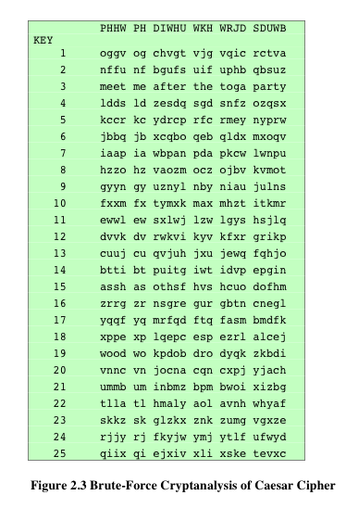
Brute-Force Cryptanalysis of Caesar Cipher
(This chart can be found on page 40 in the textbook)
Notes:
If it is known that a given ciphertext is a Caesar cipher, then a brute-force
cryptanalysis is easily performed: simply try all the 25 possible keys. Figure 2.3
shows the results of applying this strategy to the example ciphertext. In this case, the
plaintext leaps out as occupying the third line.
Three important characteristics of this problem enabled us to use a brute-force
cryptanalysis:
1. The encryption and decryption algorithms are known.
2. There are only 25 keys to try.
3. The language of the plaintext is known and easily recognizable.

Slide 19
Monoalphabetic Cipher
Permutation
Of a finite set of elements S is an ordered sequence of all the elements of S , with each element appearing exactly once
If the “cipher” line can be any permutation of the 26 alphabetic characters, then there are 26! or greater than 4 x 10²⁶ possible keys
This is 10 orders of magnitude greater than the key space for DES
Approach is referred to as a monoalphabetic substitution cipher because a single cipher alphabet is used per message
Notes:
With only 25 possible keys, the Caesar cipher is far from secure. A dramatic increase
in the key space can be achieved by allowing an arbitrary substitution. Before proceeding,
we define the term permutation . A permutation of a finite set of elements S
is an ordered sequence of all the elements of S , with each element appearing exactly
once.
For example, if S = {a, b, c}, there are six permutations of S :
abc, acb, bac, bca, cab, cba
In general, there are n ! permutations of a set of n elements, because the first
element can be chosen in one of n ways, the second in n - 1 ways, the third in n - 2
ways, and so on.
If, instead, the “cipher” line can be any permutation of the 26 alphabetic characters,
then there are 26! or greater than 4 * 10²⁶ possible keys. This is 10 orders of magnitude
greater than the key space for DES and would seem to eliminate brute-force
techniques for cryptanalysis. Such an approach is referred to as a monoalphabetic
substitution cipher , because a single cipher alphabet (mapping from plain alphabet
to cipher alphabet) is used per message.

Slide 20
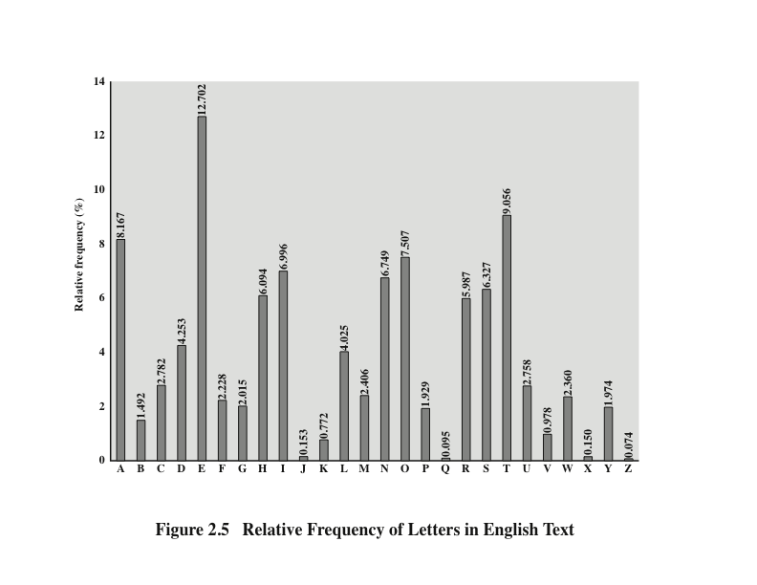
Notes:
There is, however, another line of attack. If the cryptanalyst knows the nature
of the plaintext (e.g., noncompressed English text), then the analyst can exploit the
regularities of the language. To see how such a cryptanalysis might proceed, we give
a partial example here that is adapted from one in [SINK09]. The ciphertext to be
solved is
UZQSOVUOHXMOPVGPOZPEVSGZWSZOPFPESXUDBMETSXAIZ
VUEPHZHMDZSHZOWSFPAPPDTSVPQUZWYMXUZUHSX
EPYEPOPDZSZUFPOMBZWPFUPZHMDJUDTMOHMQ
As a first step, the relative frequency of the letters can be determined and
compared to a standard frequency distribution for English, such as is shown in
Figure 2.5 (based on [LEWA00]). If the message were long enough, this technique
alone might be sufficient, but because this is a relatively short message, we cannot
expect an exact match. In any case, the relative frequencies of the letters in the
ciphertext (in percentages) are as follows:
P 13.33 H 5.83 F 3.33 B 1.67 C 0.00
Z 11.67 D 5.00 W 3.33 G 1.67 K 0.00
S 8.33 E 5.00 Q 2.50 Y 1.67 L 0.00
U 8.33 V 4.17 T 2.50 I 0.83 N 0.00
O 7.50 X 4.17 A 1.67 J 0.83 R 0.00
M 6.67
Comparing this breakdown with Figure 2.5, it seems likely that cipher letters P
and Z are the equivalents of plain letters e and t, but it is not certain which is which.
The letters S, U, O, M, and H are all of relatively high frequency and probably correspond
to plain letters from the set {a, h, i, n, o, r, s}. The letters with the lowest
frequencies (namely, A, B, G, Y, I, J) are likely included in the set {b, j, k, q, v, x, z}.
There are a number of ways to proceed at this point. We could make some tentative
assignments and start to fill in the plaintext to see if it looks like a reasonable
“skeleton” of a message. A more systematic approach is to look for other regularities.
For example, certain words may be known to be in the text. Or we could look for
repeating sequences of cipher letters and try to deduce their plaintext equivalents.

Slide 21
Monoalphabetic Ciphers
Easy to break because they reflect the frequency data of the original alphabet
Countermeasure is to provide multiple substitutes (homophones) for a single letter
Digram
Two-letter combination
Most common is th
Trigram
Three-letter combination
Most frequent is the
Notes:
A powerful tool is to look at the frequency of two-letter combinations, known
as digrams . A table similar to Figure 2.5 could be drawn up showing the relative frequency
of digrams. The most common such digram is th. In our ciphertext, the most
common digram is ZW, which appears three times. So we make the correspondence
of Z with t and W with h. Then, by our earlier hypothesis, we can equate P with e.
Now notice that the sequence ZWP appears in the ciphertext, and we can translate
that sequence as “the.” This is the most frequent trigram (three-letter combination)
in English, which seems to indicate that we are on the right track.
Next, notice the sequence ZWSZ in the first line. We do not know that these
four letters form a complete word, but if they do, it is of the form th_t. If so, S
equates with a.
So far, then, we have
UZQSOVUOHXMOPVGPOZPEVSGZWSZOPFPESXUDBMETSXAIZ
t a e e te a that e e a a
VUEPHZHMDZSHZOWSFPAPPDTSVPQUZWYMXUZUHSX
e t ta t ha e ee a e th t a
EPYEPOPDZSZUFPOMBZWPFUPZHMDJUDTMOHMQ
e e e tat e the t
Only four letters have been identified, but already we have quite a bit of the
message. Continued analysis of frequencies plus trial and error should easily yield a
solution from this point. The complete plaintext, with spaces added between words,
follows:
it was disclosed yesterday that several informal but
direct contacts have been made with political
representatives of the Viet cong in Moscow
Monoalphabetic ciphers are easy to break because they reflect the frequency
data of the original alphabet. A countermeasure is to provide multiple substitutes,
known as homophones, for a single letter. For example, the letter e could be assigned
a number of different cipher symbols, such as 16, 74, 35, and 21, with each
homophone assigned to a letter in rotation or randomly. If the number of symbols
assigned to each letter is proportional to the relative frequency of that letter, then
single-letter frequency information is completely obliterated. The great mathematician
Carl Friedrich Gauss believed that he had devised an unbreakable cipher using
homophones. However, even with homophones, each element of plaintext affects
only one element of ciphertext, and multiple-letter patterns (e.g., digram frequencies)
still survive in the ciphertext, making cryptanalysis relatively straightforward.
Two principal methods are used in substitution ciphers to lessen the extent to
which the structure of the plaintext survives in the ciphertext: One approach is to
encrypt multiple letters of plaintext, and the other is to use multiple cipher alphabets.
We briefly examine each.

Slide 22
Playfair Cipher
Best-known multiple-letter encryption cipher
Treats digrams in the plaintext as single units and translates these units into ciphertext digrams
Based on the use of a 5 x 5 matrix of letters constructed using a keyword
Invented by British scientist Sir Charles Wheatstone in 1854
Used as the standard field system by the British Army in World War I and the U.S. Army and other Allied forces during World War II
Notes:
The best-known multiple-letter encryption cipher is the Playfair, which treats
digrams in the plaintext as single units and translates these units into ciphertext
Digrams.
The Playfair algorithm is based on the use of a 5 * 5 matrix of letters constructed
using a keyword.

Slide 23
Playfair Key Matrix
Fill in letters of keyword (minus duplicates) from left to right and from top to bottom, then fill in the remainder of the matrix with the remaining letters in alphabetic order
Using the keyword MONARCHY:
M | O | N | A | R
C | H | Y | B | D
E | F | G | I/J | K
L | P | Q | S | T
U | V | W | X | Z
Notes:
In this case, the keyword is monarchy . The matrix is constructed by filling
in the letters of the keyword (minus duplicates) from left to right and from top to
bottom, and then filling in the remainder of the matrix with the remaining letters in
alphabetic order. The letters I and J count as one letter. Plaintext is encrypted two
letters at a time, according to the following rules:
1. Repeating plaintext letters that are in the same pair are separated with a filler
letter, such as x, so that balloon would be treated as ba lx lo on.
2. Two plaintext letters that fall in the same row of the matrix are each replaced
by the letter to the right, with the first element of the row circularly following
the last. For example, ar is encrypted as RM.
3. Two plaintext letters that fall in the same column are each replaced by the
letter beneath, with the top element of the column circularly following the last.
For example, mu is encrypted as CM.
4. Otherwise, each plaintext letter in a pair is replaced by the letter that lies in
its own row and the column occupied by the other plaintext letter. Thus, hs
becomes BP and ea becomes IM (or JM, as the encipherer wishes).
The Playfair cipher is a great advance over simple monoalphabetic ciphers.
For one thing, whereas there are only 26 letters, there are 26 * 26 = 676 digrams, so
that identification of individual digrams is more difficult. Furthermore, the relative
frequencies of individual letters exhibit a much greater range than that of digrams,
making frequency analysis much more difficult. For these reasons, the Playfair
cipher was for a long time considered unbreakable. It was used as the standard field
system by the British Army in World War I and still enjoyed considerable use by the
U.S. Army and other Allied forces during World War II.
Despite this level of confidence in its security, the Playfair cipher is relatively
easy to break, because it still leaves much of the structure of the plaintext language
intact. A few hundred letters of ciphertext are generally sufficient.

Slide 24
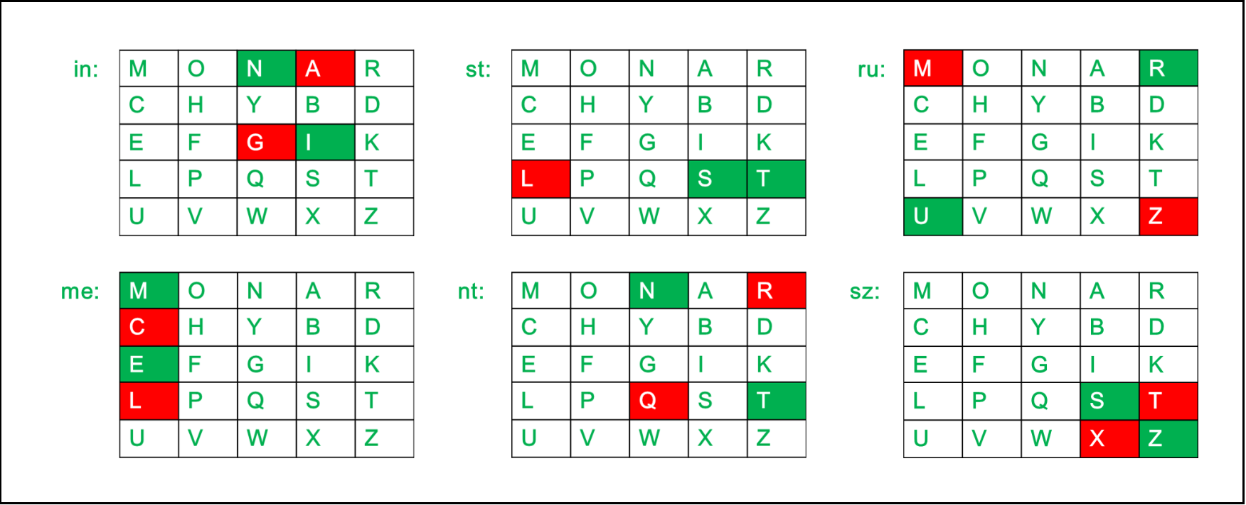
Key: Monarchy
Plaintext : instruments
Cipher: agtlmzclrqtx

Slide 25
Polyalphabetic Ciphers
Polyalphabetic substitution cipher
Improves on the simple monoalphabetic technique by using different monoalphabetic substitutions as one proceeds through the plaintext message
All these techniques have the following features in common:
A set of related monoalphabetic substitution rules is used
A key determines which particular rule is chosen for a given transformation
Notes:
Another way to improve on the simple monoalphabetic technique is to use different
monoalphabetic substitutions as one proceeds through the plaintext message.
The general name for this approach is polyalphabetic substitution cipher . All these
techniques have the following features in common:
1. A set of related monoalphabetic substitution rules is used.
2. A key determines which particular rule is chosen for a given transformation.

Slide 26
Vigenère Cipher
Best known and one of the simplest polyalphabetic substitution ciphers
In this scheme the set of related monoalphabetic substitution rules consists of the 26 Caesar ciphers with shifts of 0 through 25
Each cipher is denoted by a key letter which is the ciphertext letter that substitutes for the plaintext letter a
Notes:
The best known, and one of the simplest, polyalphabetic ciphers
is the Vigenère cipher. In this scheme, the set of related monoalphabetic substitution
rules consists of the 26 Caesar ciphers with shifts of 0 through 25. Each cipher is
denoted by a key letter, which is the ciphertext letter that substitutes for the plaintext
letter a. Thus, a Caesar cipher with a shift of 3 is denoted by the key value 3.

Slide 27
Example of Vigenère Cipher
To encrypt a message, a key is needed that is as long as the message
Usually, the key is a repeating keyword
For example, if the keyword is deceptive, the message “we are discovered save yourself” is encrypted as:
key: deceptivedeceptivedeceptive
plaintext: wearediscoveredsaveyourself
ciphertext: ZICVTWQNGRZGVTWAVZHCQYGLMGJ
Notes:
To encrypt a message, a key is needed that is as long as the message. Usually,
the key is a repeating keyword. For example, if the keyword is deceptive , the
message “we are discovered save yourself” is encrypted as
key: deceptivedeceptivedeceptive
plaintext: wearediscoveredsaveyourself
ciphertext: ZICVTWQNGRZGVTWAVZHCQYGLMGJ
The strength of this cipher is that there are multiple ciphertext letters for
each plaintext letter, one for each unique letter of the keyword. Thus, the letter
frequency information is obscured. However, not all knowledge of the plaintext
structure is lost. For example, Figure 2.6 shows the frequency distribution for a
Vigenère cipher with a keyword of length 9. An improvement is achieved over the
Playfair cipher, but considerable frequency information remains.

Slide 28
Vigenère Autokey System
A keyword is concatenated with the plaintext itself to provide a running key
Example:
key: deceptivewearediscoveredsav
plaintext: wearediscoveredsaveyourself
ciphertext: ZICVTWQNGKZEIIGASXSTSLVVWLA
Even this scheme is vulnerable to cryptanalysis
Because the key and the plaintext share the same frequency distribution of letters, a statistical technique can be applied
Notes:
The periodic nature of the keyword can be eliminated by using a nonrepeating
keyword that is as long as the message itself. Vigenère proposed what is referred to
as an autokey system , in which a keyword is concatenated with the plaintext itself to
provide a running key. For our example,
key: deceptivewearediscoveredsav
plaintext: wearediscoveredsaveyourself
ciphertext: ZICVTWQNGKZEIIGASXSTSLVVWLA
Even this scheme is vulnerable to cryptanalysis. Because the key and the
plaintext share the same frequency distribution of letters, a statistical technique
can be applied. For example, e enciphered by e , by Figure 2.5, can be expected to
occur with a frequency of (0.127⁾² = 0.016, whereas t enciphered by t would occur
only about half as often. These regularities can be exploited to achieve successful
cryptanalysis.

Slide 29
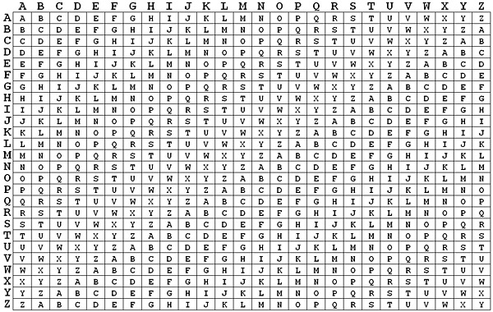

Slide 30

The One Time Pad
Since perfect secrecy is attainable, one might be tempted to ask why it is not used universally and why people use systems that may be broken?
How does the receiver obtain this random sequence?
Since the sequence is randomly generated it is 'impossible' for the sender and receiver to generate the same key simultaneously.
Thus one of them must generate the key and then send it (secretly) to the other party.
If the secrecy of this key is to be guaranteed, then it needs protection during transmission.
If the communicators have only one communications link available, then they need another one-time pad random sequence to protect the first one.

Slide 31
The One Time Pad
Clearly this type of reasoning leads to the unachievable requirement of an infinite family of random sequences, each one being used to protect the previous one during its transmission from one party to the other.
Thus one-time pads can only be used if the communicators have a second secure means of exchanging information.
It is also alleged that one-time pads are used for the very highest levels of secure links, such as the Moscow-Washington hotlines.
In these situations a number of random sequences can be generated, stored, and then carried to the other locations by secure courier services.

Slide 32
The One Time Pad
The sequences can then be stored in highly protected locations, produced when required and destroyed immediately after use.
It is important to realize that this second secure channel is both slow and expensive.
It could not be used for sending the messages since immediate responses and reactions may be required.
The need for a second secure channel is common.
Even if there is a second, secure link, the one-time pad is unsuitable for systems that include many nodes, where each requires a secure link with every other.
Despite offering ultimate security, there are very few practical communications networks systems that use the one-time pad.
KEY STORAGE IS ALSO HUGE ISSUE

Slide 33
The One Time Pad
Here the problem is likely to be that of keeping track of which keys have been used and, possibly, handling the sheer volume of key material.
Perfect secrecy depends upon each key being used only once. Thus, the amount of key material required for a large, heavily used network is likely to make the overall key management totally impractical.
Not surprisingly, despite the fact that it offers the ultimate security level, there are very few practical communications networks systems that use the one-time pad.
Of course, if someone is encrypting files to be stored for their own private use then they have no need to distribute any keys.
In many storage scenarios, the only problems relate to key storage

Slide 34
Modern Encryption Principles
An encryption scheme has 5 ingredients
Plaintext,
Encryption Algorithm,
Key,
Ciphertext, and
Decryption Algorithm
Security depends on secrecy of the key, not algorithm
Recall Kerckhoff

Slide 35
Notations
M, or P will usually denote the plaintext message
C will usually denote the ciphertext
K will usually denote a key
E_{k}(M)=C is the encryption function
D_{k}(C)=M is the decryption function
D_{k}(E_{k}(M))=M represents the typical flow

Slide 37
A Generic Network Access Security Model
Internal Network
Computers
Software Resources
Databases
Security
Control
Gateway
Opponent, Intruder
Access Channel
The medum through
Which packets are
flowing
Like a firewall protecting our network,
Filters the contents which are
flowing

Slide 38
Cryptography Terminologies
Most important concept behind network security is encryption
Two forms of encryption
Private or symmetric key
Single key shared by source and Destination
Public or Asymmetric key
Separate keys for sender and receiver
One for encryption and the other one for decryption
Trusted third party is basically the certification authority
Responsible for distributing the keys for sender and receiver.
Secrecy of keys is most important and crucial
Trusted third party
message
Encryption Algo
Decryption Algo
message
Key 1
Key 2
channel
Sender
Receiver

Slide 40
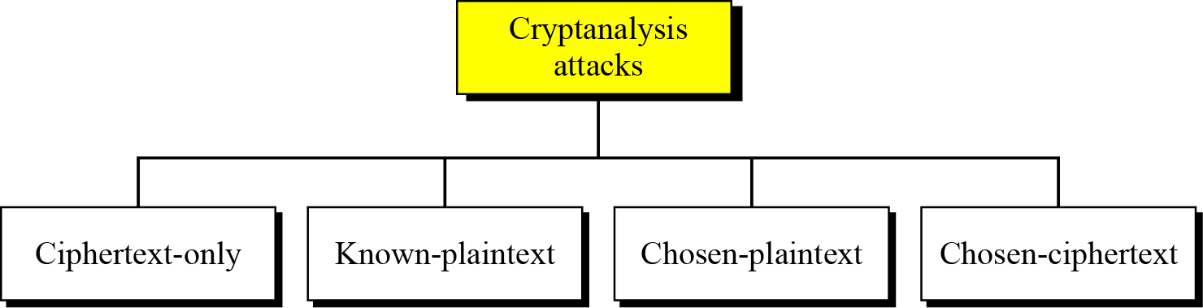
Cryptanalysis
As cryptography is the science and art of creating secret codes, cryptanalysis is the science and art of breaking those codes.

Slide 41
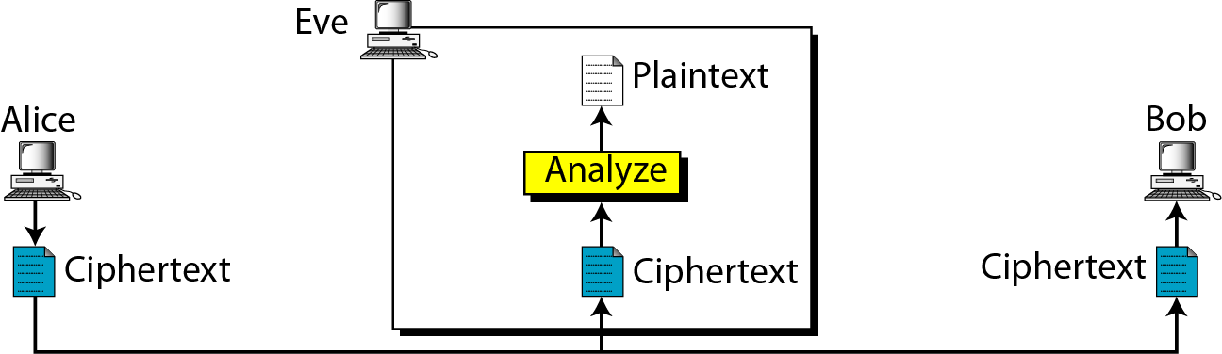
Ciphertext-Only Attack
Intruder only has the cyphertext to analyze
Notes:
Ceaser Cipher

Slide 42
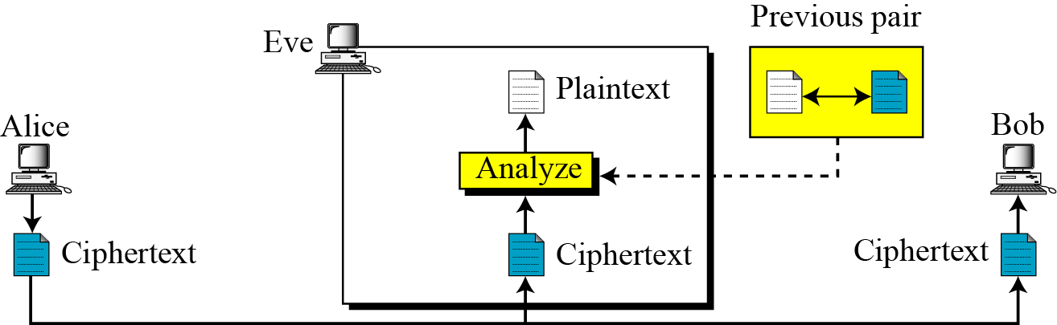
Known-Plaintext Attack
Intruder uses a set of known plaintexts and corresponding ciphertexts

Slide 43
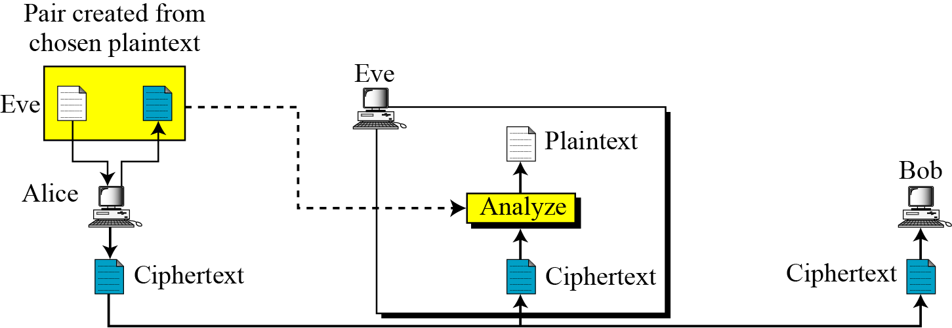
Chosen-Plaintext Attack
Attacker chooses some plaintexts and somehow gets its ciphertexts. Then compares/analyzes plaintext/ciphertexts to get the key

Slide 44
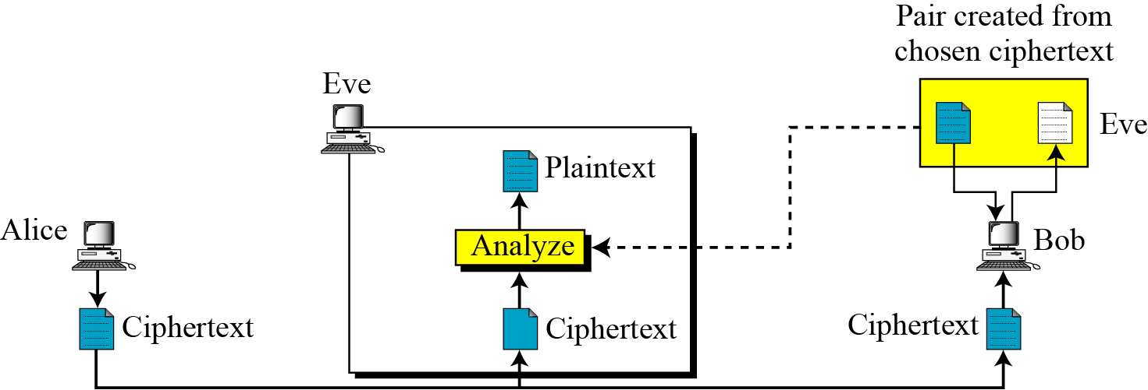
Chosen-Ciphertext Attack
Attacker chooses some ciphertexts and somehow gets its plaintexts. Then compares/analyzes plaintext/ciphertexts to get the key

Slide 45
(Basic Cryptographic Mathematics)
45
Notes:
45
45

Slide 46

Cryptographic Mathematics
Set of integers
Modular Mathematics
Find the result of the following operations:
a. 27 mod 5 b. 36 mod 12
c. −18 mod 14 d. −7 mod 10
Dividing 27 by 5 results in r = 2
Dividing 36 by 12 results in r = 0.
c. Dividing −18 by 14 results in r = −4. After adding the modulus r = 10
d. Dividing −7 by 10 results in r = −7. After adding the modulus to −7, r = 3.

Slide 47
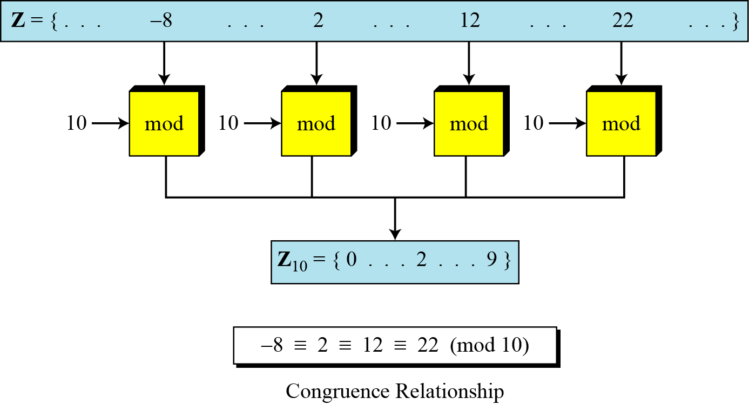
Cryptographic Mathematics
To show that two integers are congruent, we use the congruence operator ( ≡ ). For example, we write:
Concept of Zn

Slide 48
Modular Arithmetics
Concept of Z_{n} : A set {0,1,2,…..(n-1)}
Exercise
a. Add 17 to 27 in Z₁₄.
b. Subtract 43 from 12 in Z₁₃.
c. Multiply 123 by −10 in Z₁₉.

Slide 50


Cryptographic Mathematics
Finding Power in modulo arithmetic
In Z_{n}, two numbers a and b are additive inverses of each other if
In Z_{n}, two numbers a and b are multiplicative inverses of each other if

Slide 51
Cryptographic mathematics
Find all additive inverse pairs in Z10.
The six pairs of additive inverses are (0, 0), (1, 9), (2, 8), (3, 7), (4, 6), and (5, 5).
Find the multiplicative inverse of 8 in Z₁₀.
Gcd(8,10) !=0 so does not exist
Find all multiplicative inverses in Z₁₀.
There are only three pairs: (1, 1), (3, 7) and (9, 9). The numbers 0, 2, 4, 5, 6, and 8 do not have a multiplicative inverse.
Find all multiplicative inverse pairs in Z₁₁.
We have seven pairs: (1, 1), (2, 6), (3, 4), (5, 9), (7, 8) and (10, 10).
Note 11 is prime so every number from 0 to n-1 has a multiplicative inverse
We Will Study in Detail finding the multiplicative inverse in Asymmetric Key Cryptography.

Slide 52
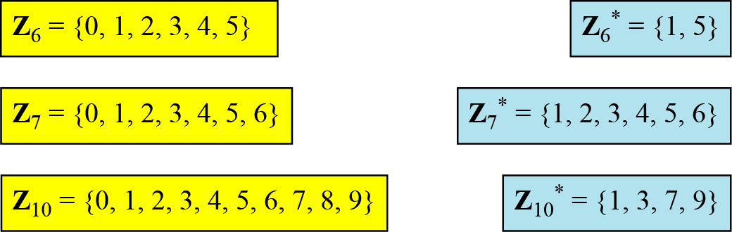
Cryptographic Mathematics
Z_{n} and Z_{n*}
Cryptography often uses two more sets: Z_{p} and Z_{p*}. The modulus in these two sets is a prime number.

Slide 53

Advanced Cryptography-I
(Symmetric Key Cryptography)
53
Notes:
53
53

Slide 54
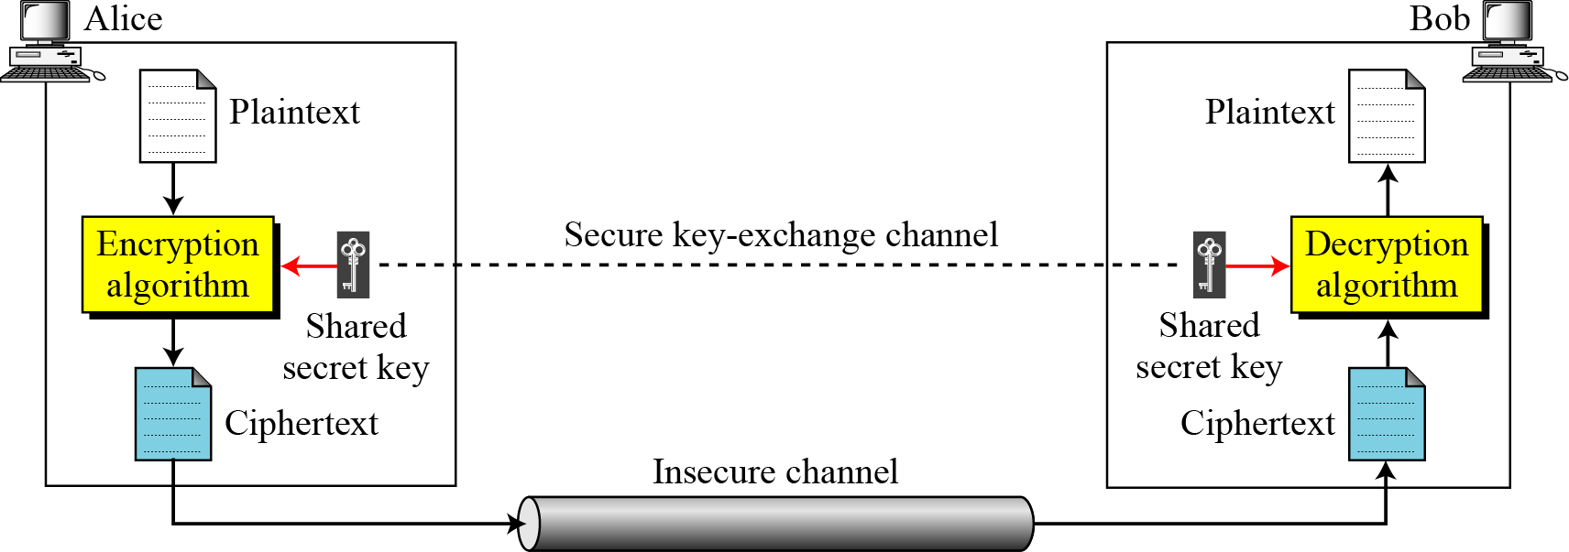
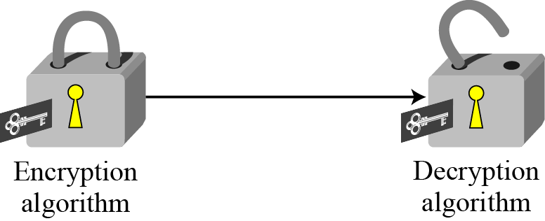
Symmetric Key Cryptographyof symmetric-key cipher

Slide 55
Symmetric Key Cryptography
Basic Ingredients of the scheme are
Plaintext(P)
Message to be encrypted
Secret Key(K)
Shared among the two parties
Ciphertext(C)
Message after encryption
Encryption Algorithm (EA)
Uses P and K
Decryption Algorithm(DA)
Uses C and K
Seucrity of the scheme
Depends on the secrecy of the key and not algorithm

Slide 56
Symmetric Key Cryptography
Assumptions
Algorithms for encryption/decryption are known to public
Keys used are kept secret.
Illustration:
Points to Observe:
Establish key before communication
Need n(n-1)/2 keys with n different parties
Shared key K
Shared key K
Ciphertext
Decryption
Algo
Plaintext
Plaintext
Encryption
Algo

Slide 57
Symmetric Key Cryptography
Two Categories of Classical Symmetric Key Cryptography
Substitution:
Letters of groups of letters of plaintext are replaced by other group of letters (Replacement method is kept secret)
Transposition:
Letters of the plaintext are permuted in some form
GOOD can become DOOG or GDOG

Slide 58
Another Classification of Encryption Algorithms
Stream Ciphers and Block Ciphers
A stream Cipher encrypts the plaintext bit by bit (in streams)
A block Cipher encrypts n-bit blocks at a time
E.g. a 256 bit cipher encrypts ‘256’ bit blocks at a time
Short blocks need to be padded up
Stream Ciphers are very cheap and can be implemented on hardware itself
Sending speech over phone?
Stream Cipher
B1
B2
B3
B4
01000101
11000011
K

Slide 59
Practical Algorithms
Data Encryption Standard (DES)
One of the oldest
Block size is 64 bits
Key is 56 bits
IDEA
Block size is 64 bits
Key size is 128 bits
Advanced Encryption Standard (AES)
Also Known as Rinjadell Cryptosystem
Block size can be 128, 192 or 256 bits
Key size can be 128, 192 or 256 bits

